Slide 1
File organization and indexing

Slide 2
In a Database Management System (DBMS), indexing and hashing are two techniques used to improve data retrieval efficiency.
Indexing is a data structure technique that allows for faster retrieval of records from a database.
It's similar to the index in a book, where you can find the page number of a topic rather than searching through the entire book.

Slide 3
Purpose: The primary purpose of indexing is to speed up the retrieval of records by reducing the number of disk accesses required during query execution.
How it works: An index is created on one or more columns of a table. Instead of scanning the entire table, the DBMS can use the index to directly locate the required data

Slide 4
Common Index Structures:
B-tree/B+-tree: A balanced tree structure that maintains sorted data and allows searches, sequential access, insertions, and deletions in logarithmic time.
If we have a table Employee(id, name, department), and we frequently search by id, an index on the id column will make those queries much faster

Slide 5
Indexing is great for range queries and sorting operations, using structures like B+-trees.
Hashing is optimized for quick access through exact matches (equality conditions)

Slide 6
create table employee22( id number primary key, name varchar2(100),phone_number varchar2(15));
BEGIN
FOR i IN 1..1500000 LOOP -- 1.5 million records
INSERT INTO Employee22 (id, name, phone_number)
VALUES (
i,
'Name_' || DBMS_RANDOM.STRING('x', 8), -- Random 8 character string for name
'9' || TO_CHAR(ROUND(DBMS_RANDOM.VALUE(1000000000, 9999999999))) -- Random 10-digit phone number starting with 9
);
END LOOP;
COMMIT;
END;
/
CREATE INDEX phone_number_idx ON Employee22 (phone_number);

Slide 7
DECLARE
start_time NUMBER;
end_time NUMBER;
v_phone_number VARCHAR2(15);
BEGIN
start_time := DBMS_UTILITY.GET_TIME;
SELECT phone_number INTO v_phone_number
FROM Employee22
WHERE phone_number = ‘99857823413';
end_time := DBMS_UTILITY.GET_TIME;
DBMS_OUTPUT.PUT_LINE('Time taken without index: ' || (end_time - start_time) || ' centiseconds');
END;
/

Slide 8
CREATE INDEX phone_number_idx ON Employee22 (phone_number);
BEGIN
EXECUTE IMMEDIATE 'DROP INDEX phone_number_idx';
EXCEPTION
WHEN OTHERS THEN
NULL; -- Ignore if index does not exist
END;
/

Slide 9
DECLARE
start_time NUMBER;
end_time NUMBER;
v_phone_number VARCHAR2(15);
BEGIN
start_time := DBMS_UTILITY.GET_TIME;
SELECT phone_number INTO v_phone_number
FROM Employee
WHERE phone_number = ‘99857823413';
end_time := DBMS_UTILITY.GET_TIME;
DBMS_OUTPUT.PUT_LINE('Time taken with index: ' || (end_time - start_time) || ' centiseconds');
END;
/

Slide 10
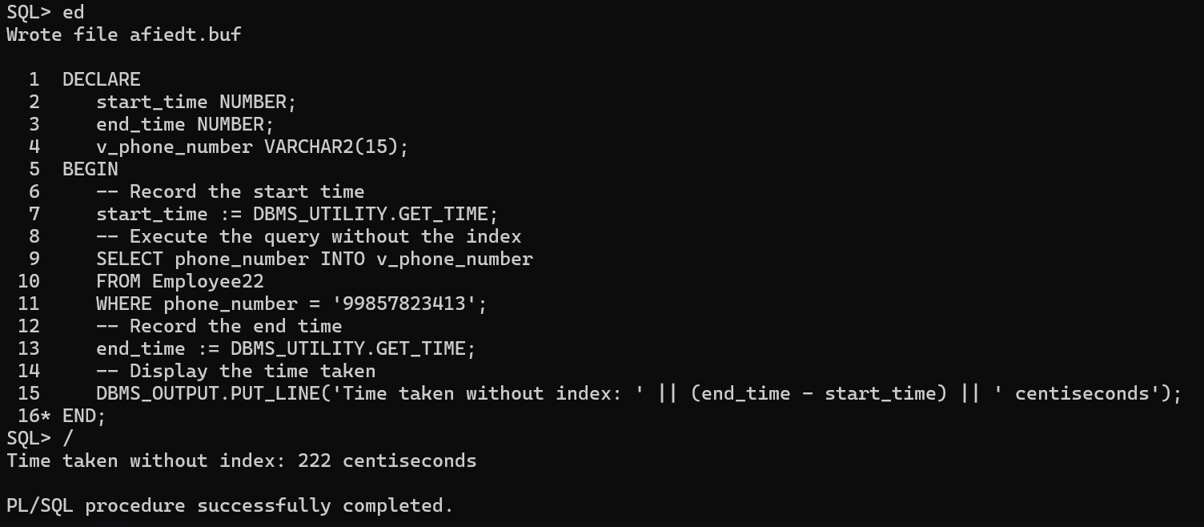

Slide 11
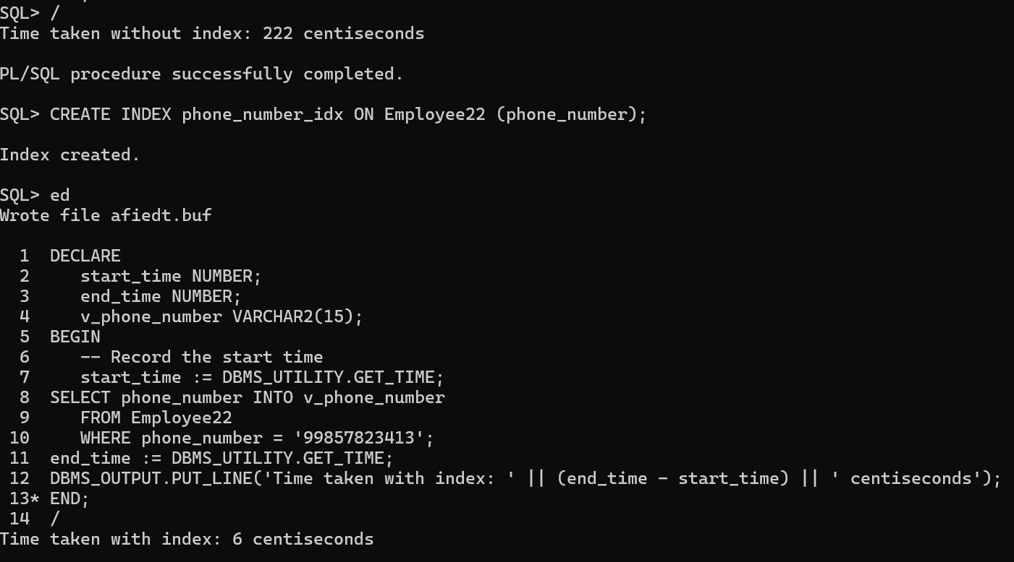

Slide 12
A file is a collection of related records stored together on a storage medium.
A record is a collection of related data items (fields). This forms the basic unit of data storage in a DBMS.
Files are typically divided into fixed-size blocks called pages, which are the smallest unit of data transfer between disk and memory. This design improves I/O efficiency.
A relation or table is typically stored as a file of records.
During data retrieval, pages are loaded into RAM (main memory) for processing. This process is part of a DBMS’s buffer management strategy, which aims to reduce the need for repeated disk I/O (which is much slower than RAM access).

Slide 13
A file organization is a method of arranging the records in a file when the file is stored on disk.
Each record in a file has a unique identifier called a record id, or rid for short. A rid has the property that we can identify the disk address of the page containing the record by using the rid.
DBMS stores vast quantities of data, and the data must persist across program executions.
Therefore, data is stored on external storage devices such as disks and tapes, and fetched into main memory as needed for processing.

Slide 14
The file of records is an important abstraction in a DBMS, and is implemented by the files and access methods layer of the code.
A file can be created, destroyed, and have records inserted into and deleted from it.
It also supports scans; a scan operation allows us to step through all the records in the file one at a time.

Slide 15
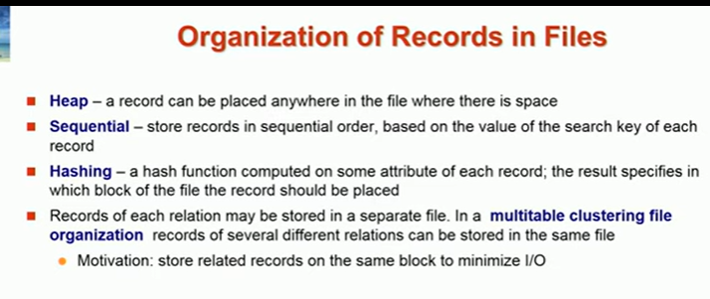

Slide 16
An index is a data structure that organizes data records on disk to optimize certain kinds of retrieval operations. An index allows us to efficiently retrieve all records that satisfy search conditions on the search key fields of the index.
We can also create additional indexes on a given collection of data records, each with a different search key, to speed up search operations that are not efficiently supported by the file organization used to store the data records.

Slide 17
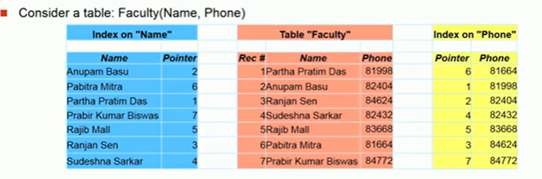
Search Records
Pointer: A pointer in an index file is a memory address or a disk location that indicates where a particular data record is stored.
Role: The pointer serves as a guide to quickly locate the actual record on disk without having to scan the entire dataset.
Index files are usually stored in the cache memory or RAM.

Slide 18
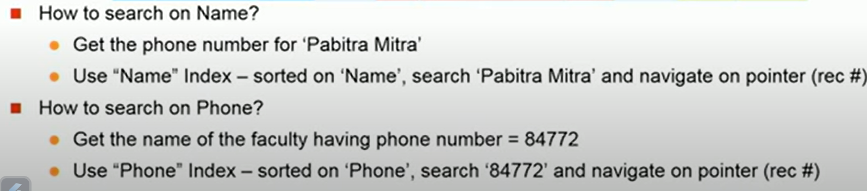
Search Records

Slide 19
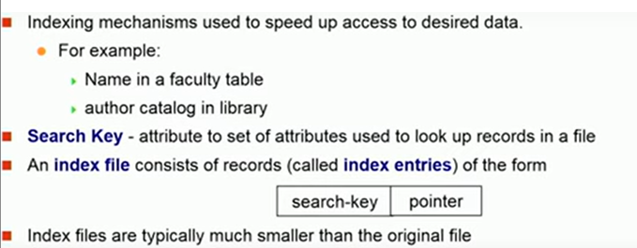

An index on a set of fields that includes the primary key is called a primary index; other indexes are called secondary indexes.
Organize data entries is to hash data entries on the search key.
Organize data entries is to build a tree-like data structure that directs a search for data entries.

Slide 20
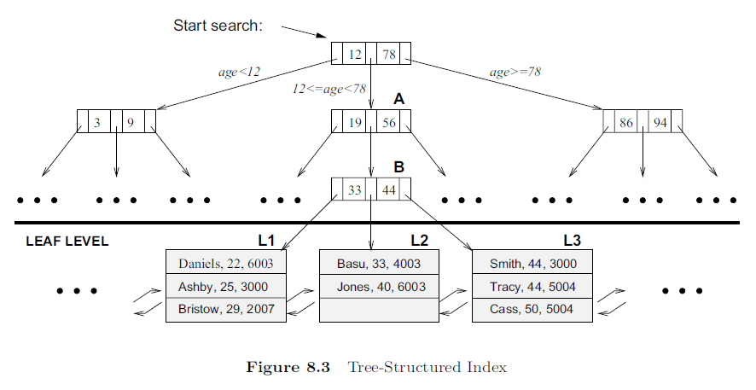
Tree-Based Indexing
The data entries are arranged in sorted order by search key value, and a hierarchical search data structure is maintained that directs searches to the correct page of data entries.
Example : Tree-structured index with search key age for an employee table with fields name, age, phone number.
The lowest level of the tree, called the leaf level, contains the data entries;
in our example, these are employee records.

Slide 21
Records with age less than 22 would appear in leaf pages to the left page L1, and records with age greater than 50 would appear in leaf pages to the right of page L3.
This structure allows us to efficiently locate all data entries with search key values in a desired range. All searches begin at the topmost node, called the root, and the contents of pages in non-leaf levels direct searches to the correct leaf page.

Slide 22
Non-leaf pages contain node pointers separated by search key values. The node pointer to the left of a key value k points to a subtree that contains only data entries less than k. The node pointer to the right of a key value k points to a subtree that contains only data entries greater than or equal to k.
Suppose we want to find all data entries with 24 < age < 50. Each edge from the root node to a child node in Figure has a label that explains what the corresponding subtree contains. (Although the labels for the remaining edges in the figure are not shown, they should be easy to deduce.)

Slide 23
In our example search, we look for data entries with search key value > 24, and get directed to the middle child, node A. Again, examining the contents of this node, we are directed to node B. Examining the contents of node B, we are directed to leaf node L1, which contains data entries we are looking for.

Slide 24
Observe that leaf nodes L2 and L3 also contain data entries that satisfy our search criterion. To facilitate retrieval of such qualifying entries during search, all leaf pages are maintained in a doubly-linked list. Thus, we can fetch page L2 using the ‘next’ pointer on page L1, and then fetch page L3 using the ‘next’ pointer on L2.

Slide 25
Thus, the number of disk I/Os incurred during a search is equal to the length of a path from the root to a leaf, plus the number of leaf pages with qualifying data entries. (Disk I/Os incurred is a measure of how many times the system needs to interact with the disk to retrieve or store data)
The B+ tree is an index structure that ensures that all paths from the root to a leaf in a given tree are of the same length, that is, the structure is always balanced in height.
Finding the correct leaf page is faster than binary search of the pages in a sorted file because each non-leaf node can accommodate a very large number of node-pointers, and the height of the tree is rarely more than three or four in practice.
The height of a balanced tree is the length of a path from root to leaf; in Figure the height is three. The number of I/Os to retrieve a desired leaf page is four, including the root and the leaf page.

Slide 26
TREE-STRUCTURED INDEXING
An ISAM tree is a static index structure that is effective when the file is not frequently updated, but it is unsuitable for files that grow and shrink a Lot. ( ISAM is a static indexing method, which means that the structure of the tree is fixed after its initial construction)
The B+ tree is a dynamic structure that adjusts to changes in the file gracefully. It is the most widely used index structure because it adjusts well to changes and supports both equality and range queries.

Slide 27
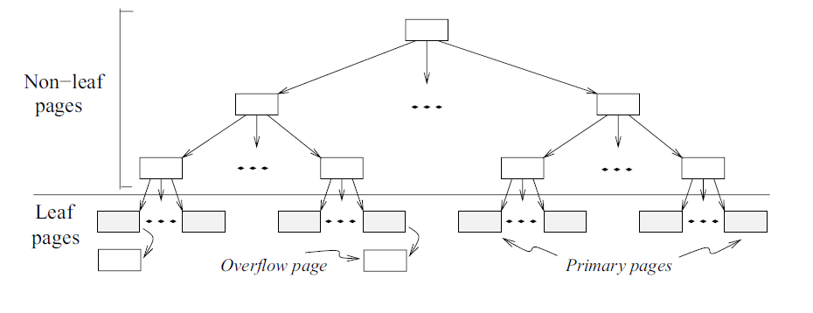
An Indexed Sequential Access Method (ISAM) tree is used for efficient data retrieval, particularly in applications that require both sequential and random access to records. ISAM is typically used in read-heavy environments where data is inserted in bulk and retrieval speed is more critical than frequent updates.

Slide 28
Static Structure:
One key characteristic of ISAM is that the tree structure is fixed once it is created.
ISAM is not dynamic like B+-trees, meaning the structure (including the number of levels and node arrangement) does not change once it has been built.
When an ISAM file is created, index nodes are fixed, and their pointers do not change during inserts and deletes that occur later (only content of leaf nodes change afterwards)

Slide 29
We use the term data entry to refer to the records stored in an index file. A data entry with search key value k, denoted as k∗, contains enough information to locate (one or more) data records with search key value k.

Slide 30
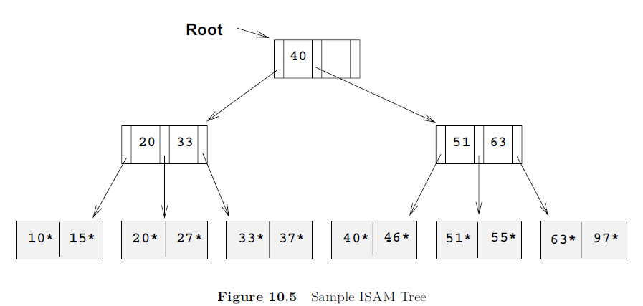
Consider the tree shown in Figure.
All searches begin at the root. For example, to locate a record with the key value 27, we start at the root and follow the left pointer, since 27 < 40. We then follow the middle pointer, since 20 <= 27 < 33. For a range search, we find the first qualifying data entry as for an equality selection and then retrieve primary leaf pages sequentially (also retrieving overflow pages as needed by following pointers from the primary pages). The primary leaf pages are assumed to be allocated sequentially—this assumption is reasonable because the number of such pages is known when the tree is created and does not change subsequently under inserts and deletes—and so ‘next leaf page’ pointers are not needed.

Slide 31
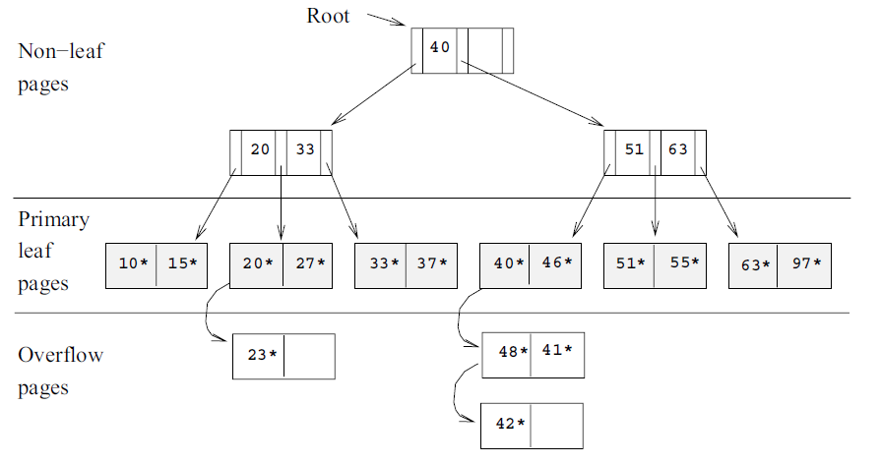
If we now insert a record with key value 23, the entry 23* belongs in the second data page, which already contains 20* and 27* and has no more space. We deal with this situation by adding an overflow page and putting 23* in the overflow page. Chains of overflow pages can easily develop. For instance, inserting 48*, 41*, and 42* leads to an overflow chain of two pages.

Slide 32
A static structure such as the ISAM index suffers from the problem that long overflow chains can develop as the file grows, leading to poor performance.
This problem motivated the development of more flexible, dynamic structures that adjust gracefully to inserts and deletes.
The B+ tree search structure, which is widely used, is a balanced tree in which the internal nodes direct the search
and the leaf nodes contain the data entries.

Slide 33
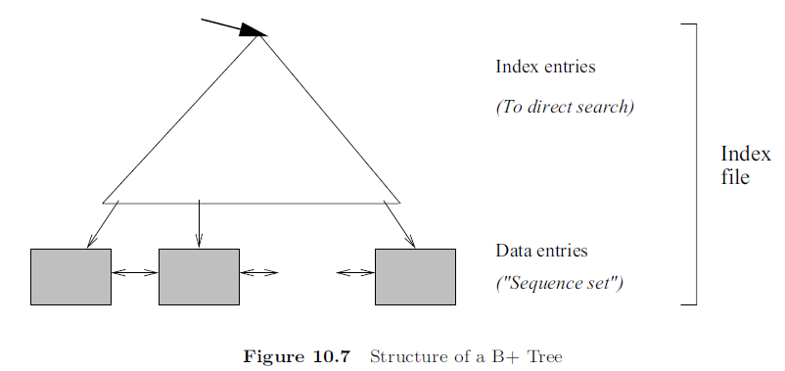
The B+ tree search structure, which is widely used, is a balanced tree in which the internal nodes direct the search
and the leaf nodes contain the data entries. Since the tree structure grows and shrinks dynamically, it is not feasible to allocate the leaf pages sequentially as in ISAM, where the set of primary leaf pages was static. To retrieve all leaf pages
efficiently, we have to link them using page pointers.

Slide 34
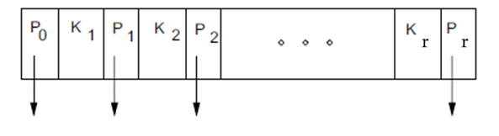
B+ trees : every node contains r entries, where d ≤ r ≤ 2d. The value d is a parameter of the B+ tree, called the order of the tree, and is a measure of the capacity of a tree node. The root node is the only exception to this requirement on the number of entries; for the root, it is simply required that 1 ≤ r ≤ 2d.
The format of a node
Non-leaf nodes with r index entries contain r+1 pointers to children.
Pointer Pi points to a subtree in which all key values K are such that Ki ≤ K < Ki+1. As special cases, P0 points to a tree in which all key values are less than K1, and Pr points to a tree in which all key values are greater than or equal to Kr. For leaf nodes, entries are denoted as K∗, as usual.
Just as in ISAM, leaf nodes (and only leaf nodes!) contain data entries.
Regardless of the alternative chosen for leaf entries, the leaf pages are chained together in a doubly linked list. Thus, the leaves form a sequence, which can be used to answer range queries efficiently.

Slide 35
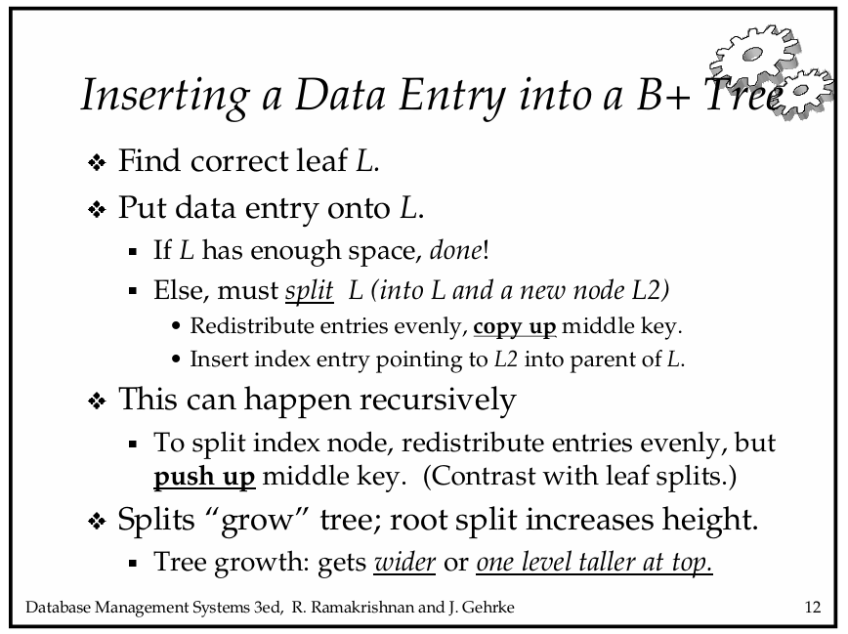

Slide 36
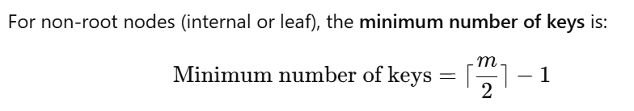
Insertion in B+ tree
How to construct a B+ tree with the number of pointers that will fit a node is m = 5.
8,11,2,23,6,16,18,10,12,40,36,9,41,26
Maximum number of keys a node can hold is m-1.
= 2.

Slide 37
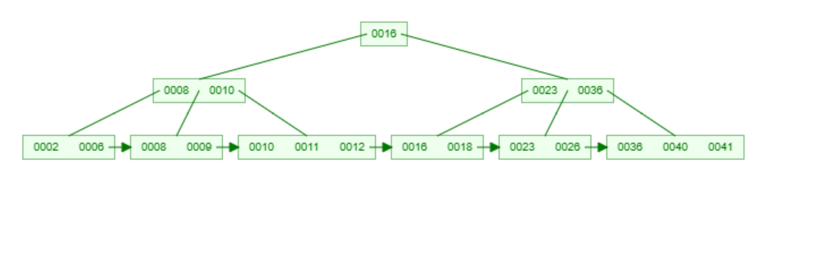
Insertion in B+ tree
How to construct a B+ tree with the number of pointers that will fit a node is m = 5.
8,11,2,23,6,16,18,10,12,40,36,9,41,26
Maximum number of keys a node can hold is m-1.

Slide 38
How to construct a B+ tree with the number of pointers that will fit a node is m = 4.
(2, 3, 5, 7, 11, 17, 19, 23, 29, 31)
The maximum number of keys it can hold is m-1 = 3.
= 1.

Slide 39
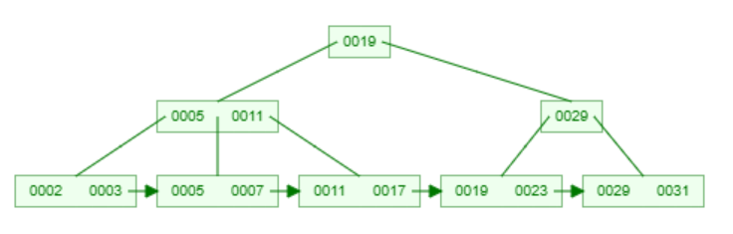
How to construct a B+ tree with the number of pointers that will fit a node is m = 4.
(2, 3, 5, 7, 11, 17, 19, 23, 29, 31)
So the maximum number of keys it can hold is m-1 = 3.

Slide 40
How to construct a B+ tree with the number of pointers that will fit a node is m = 4.
2,4,8,11,18,22,32,26,20,21,29,43

Slide 41
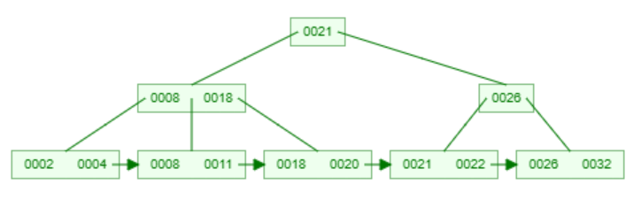
How to construct a B+ tree with the number of pointers that will fit a node is m = 4.
2,4,8,11,18,22,32,26,20,21,29,43

Slide 42
